Slide 1


Samantha Infeld, AMA Inc. and Taekyoo Won, UC Irvine
Grab-and-Go MBSE for Smallsats
MBSE
Lightning Round
www.incose.org/iw2021/

Slide 2


MBSE at NASA and the EDS MBSE Template
Making systems engineering easier for the workforce
NASA MBSE Infusion And Modernization Initiative (MIAMI) 2016-2020 and the on-going MBSE Community of Practice
Engineering Design Studio, NASA Langley Research Center (LaRC)
Tech development plan for collaboration and system modeling
AR/VR, Office 365 environment, SysML
MBSE
Lightning Round
www.incose.org/iw2021/

Slide 3
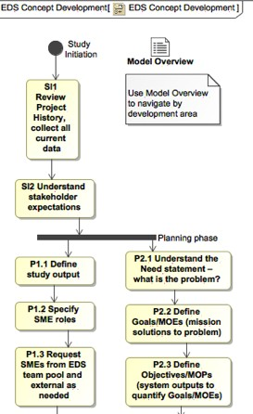
Motivation for an EDS MBSE Template
Short-term nature of EDS studies calls for a structured environment, repeatable processes, and common products
Incorporate modeling ideas and examples from studies into a re-usable template
Follow the general structure of a flight project organization, with space-based example diagrams and tables linked from each starter artifact
Assistance and consistency for navigation and tracking of the study (separate easily removable EDS package) and then the flight project
Support a consistent EDS process and successful systems engineering
throughout a project’s life
Post-study usability in the transition to project systems engineers
MBSE
Lightning Round
www.incose.org/iw2021/

Slide 4
Smallsat MBSE Template
Needs
a simple, accessible MBSE template and available libraries for rapid prototyping and transitioning models into flight project development.
rigorous, trackable System Engineering support for growing number of CubeSat projects
Goals
validate MBSE use in EDS and projects
provide direction for MBSE resources
enhance capability to rapidly reconfigure in additional variables
plug into emerging standardized smallsat model
Cubesat System Reference Model (CSRM), from INCOSE Space Systems Working Group
ease use of a smallsat modeling plug-in out of a NASA SBIR (Orbital Transport’s METIS)
MBSE
Lightning Round
– make the template ready for smoother regular use by smallsat community
www.incose.org/iw2021/

Slide 5
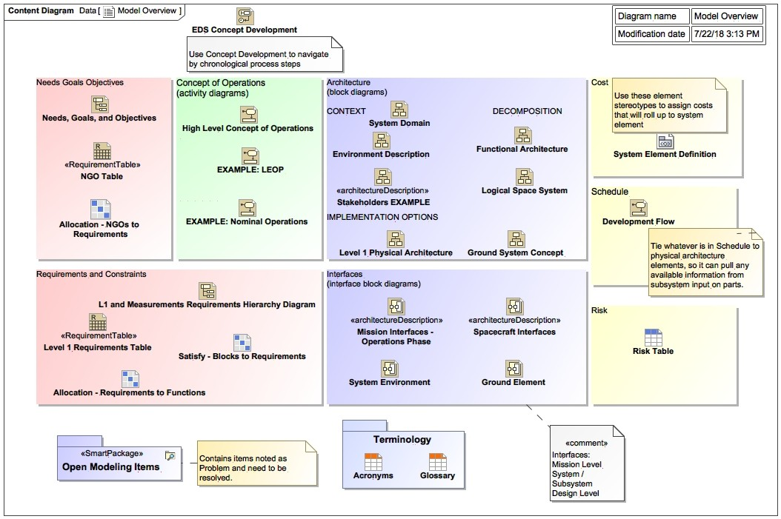
LaRC Small Satellite Template Overview
Content diagram for navigation while adding content
review and navigate the system by the major areas of concept development to ensure appropriate work is completed in each
update if diagrams/tables are added or deleted
MBSE
Lightning Round
www.incose.org/iw2021/

Slide 6
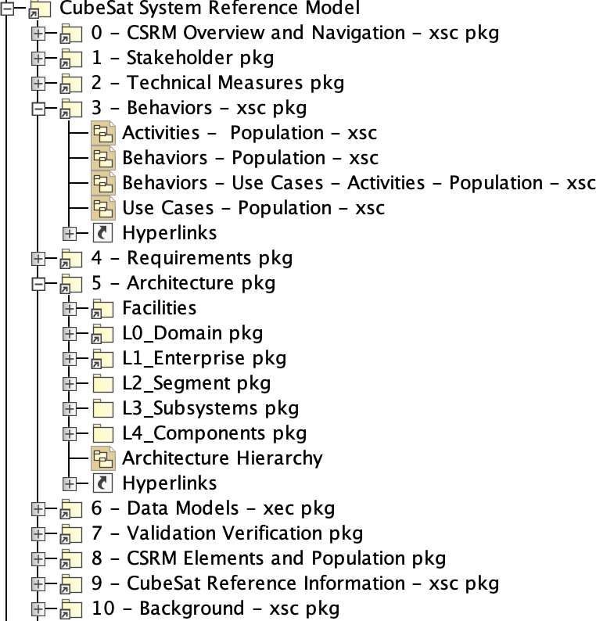
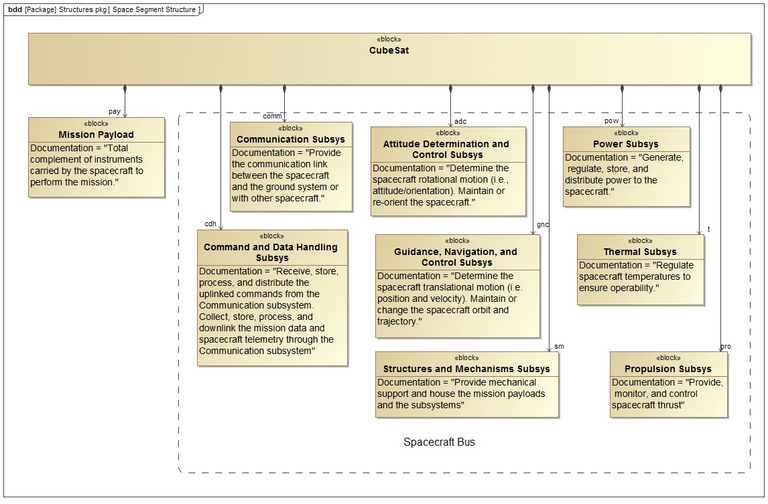
Integrated with the CSRM structure
starter diagrams contain elements placed in the correct place of CSRM
links to the population information in the CSRM
tailor, or find them in the model and create new elements in the same way
MBSE
Lightning Round
www.incose.org/iw2021/

Slide 7
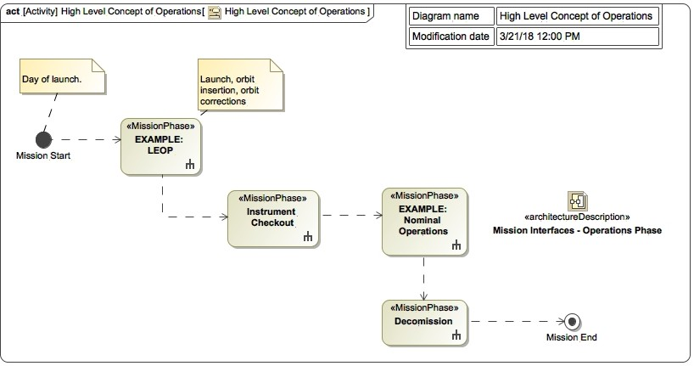
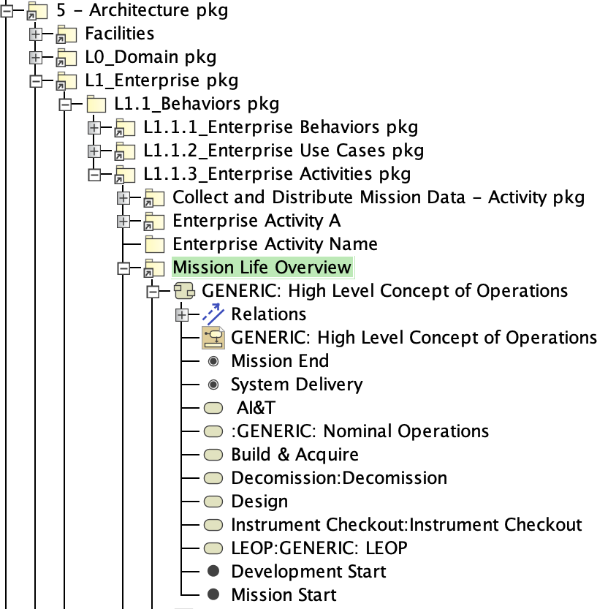
Example starter diagrams – ConOps
MBSE
Lightning Round
www.incose.org/iw2021/

Slide 8
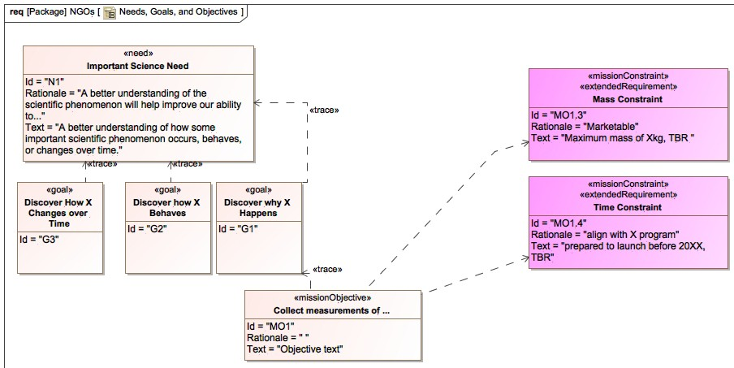
Example starter diagrams – Needs, Goals, Objectives
MBSE
Lightning Round
www.incose.org/iw2021/

Slide 9
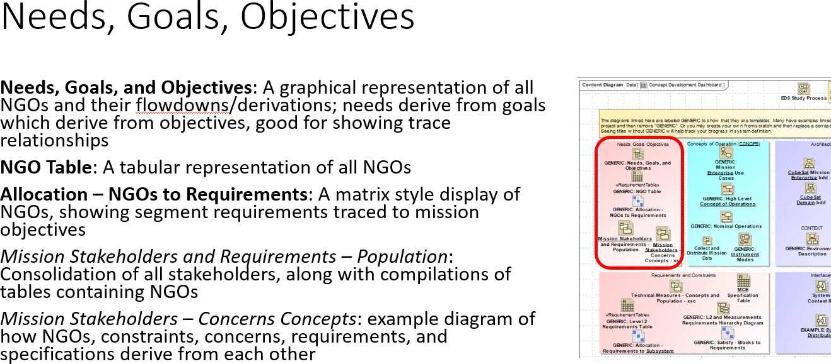
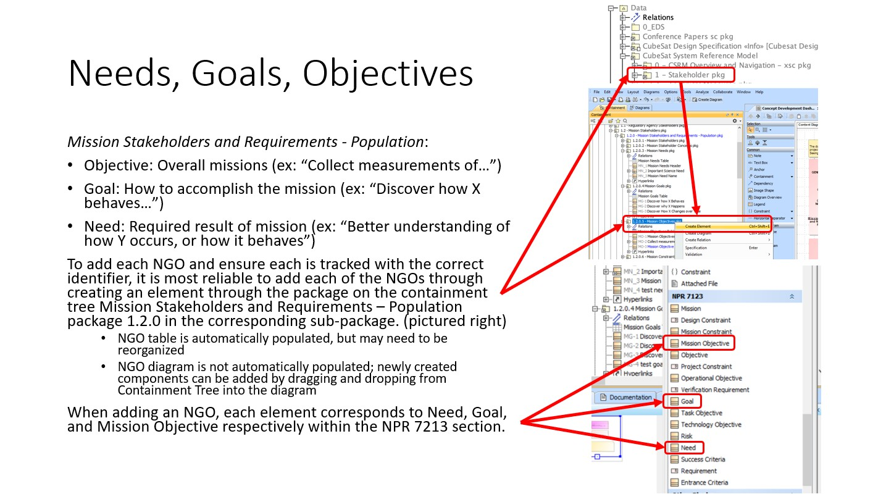
LaRC SmallSat Template User’s Guide
Guides user through each aspect of concept development as shown on Content Diagram
Needs Goals and Objectives
Concept of Operations
Architecture
Requirements and Constraints
Interfaces
MBSE
Lightning Round
www.incose.org/iw2021/

Slide 10
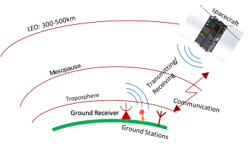
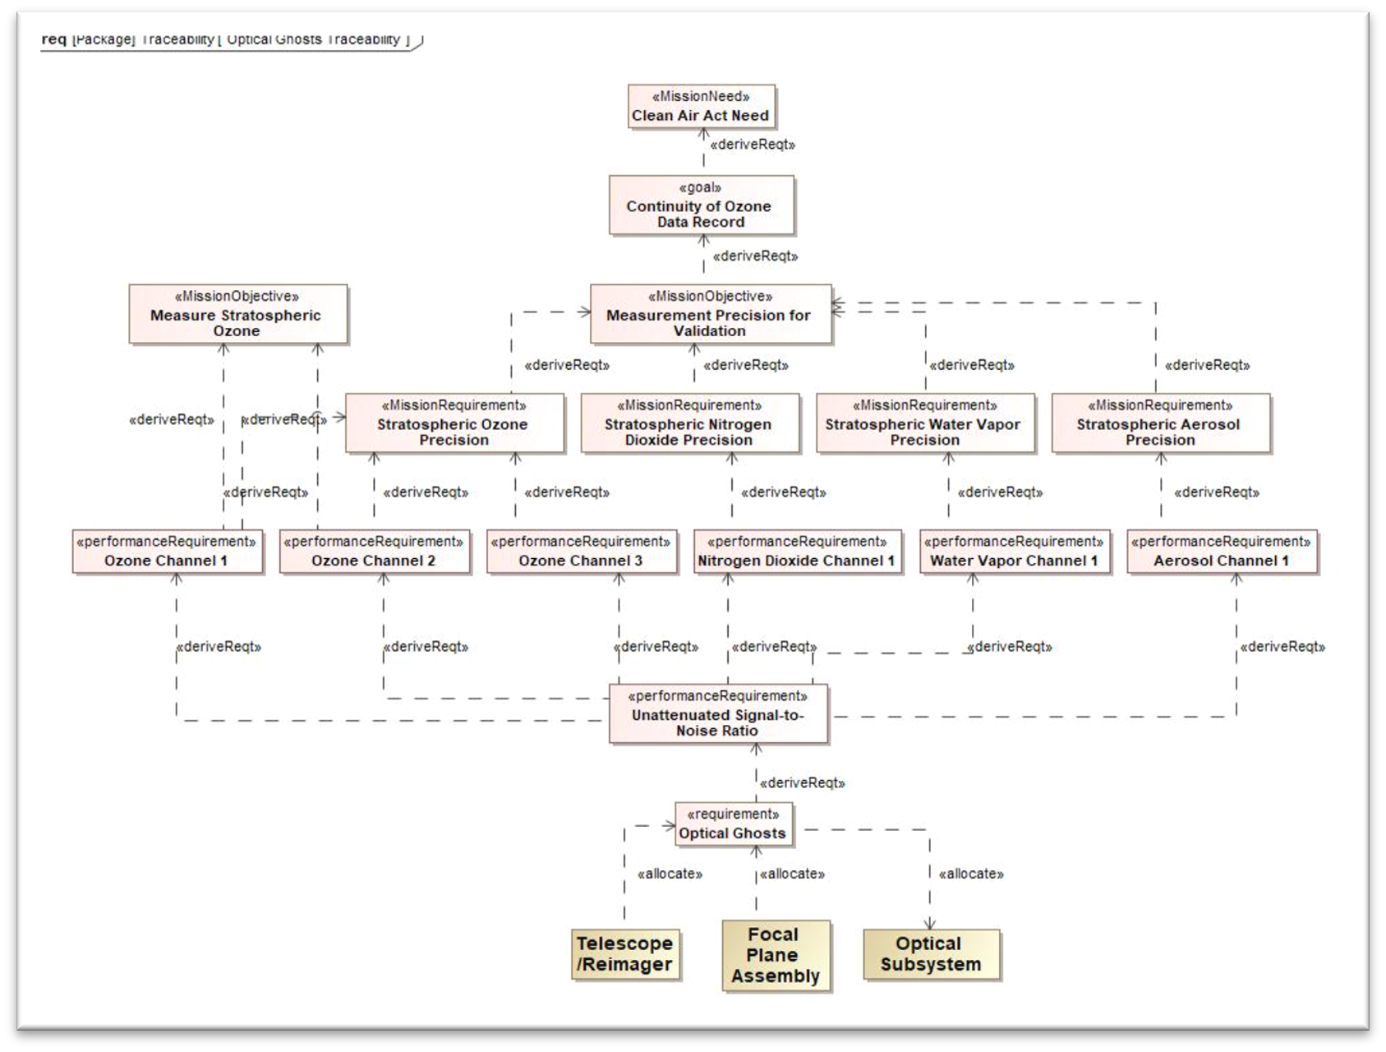
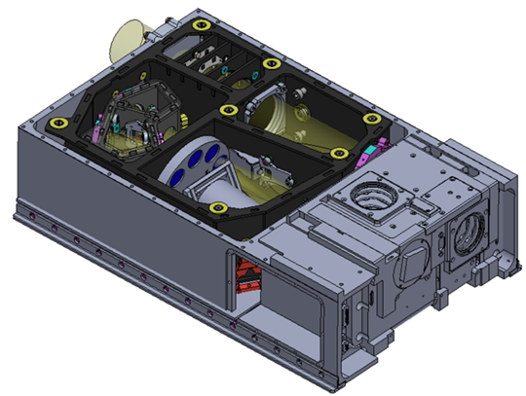
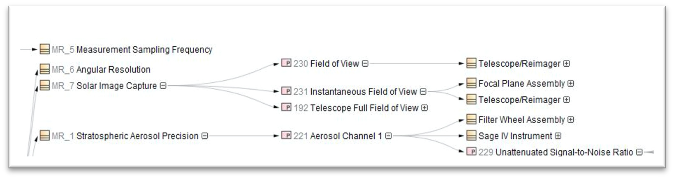
Testing with CubeSat projects
DiBAR
SAGE IV
MBSE
Lightning Round
www.incose.org/iw2021/

Slide 11


Component Library
Import satellite components and attributes directly into the model to perform trade and feasibility studies.
Desired Tool-Chain Integration Architecture
Discipline Tool 1 (e.g., ANSYS,
STK orbital, cost parametric) model, etc.)
CREO
(3D model)
Current implementation
MagicDraw SysML (on user computer, saved to agency server)
ModelCenter
ModelCenter
Microsoft Excel
Discipline Tool n
CSV import script (in MD)
ModelCenter
User edit manually or using python script
CubeSat
Component Library (in CSV/Excel)
MBSE
Lightning Round
www.incose.org/iw2021/

Slide 12
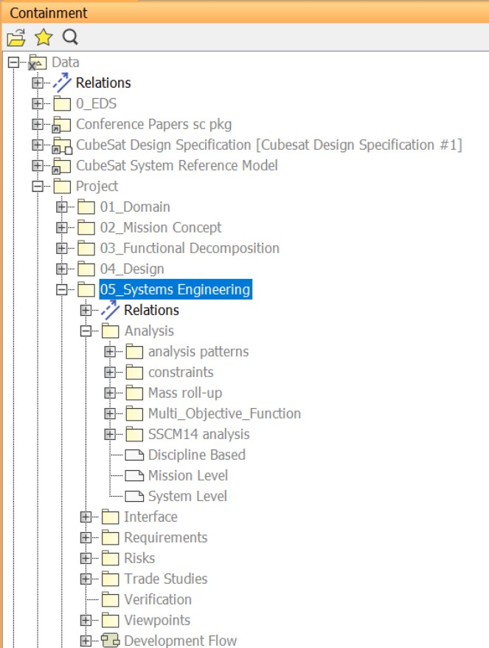
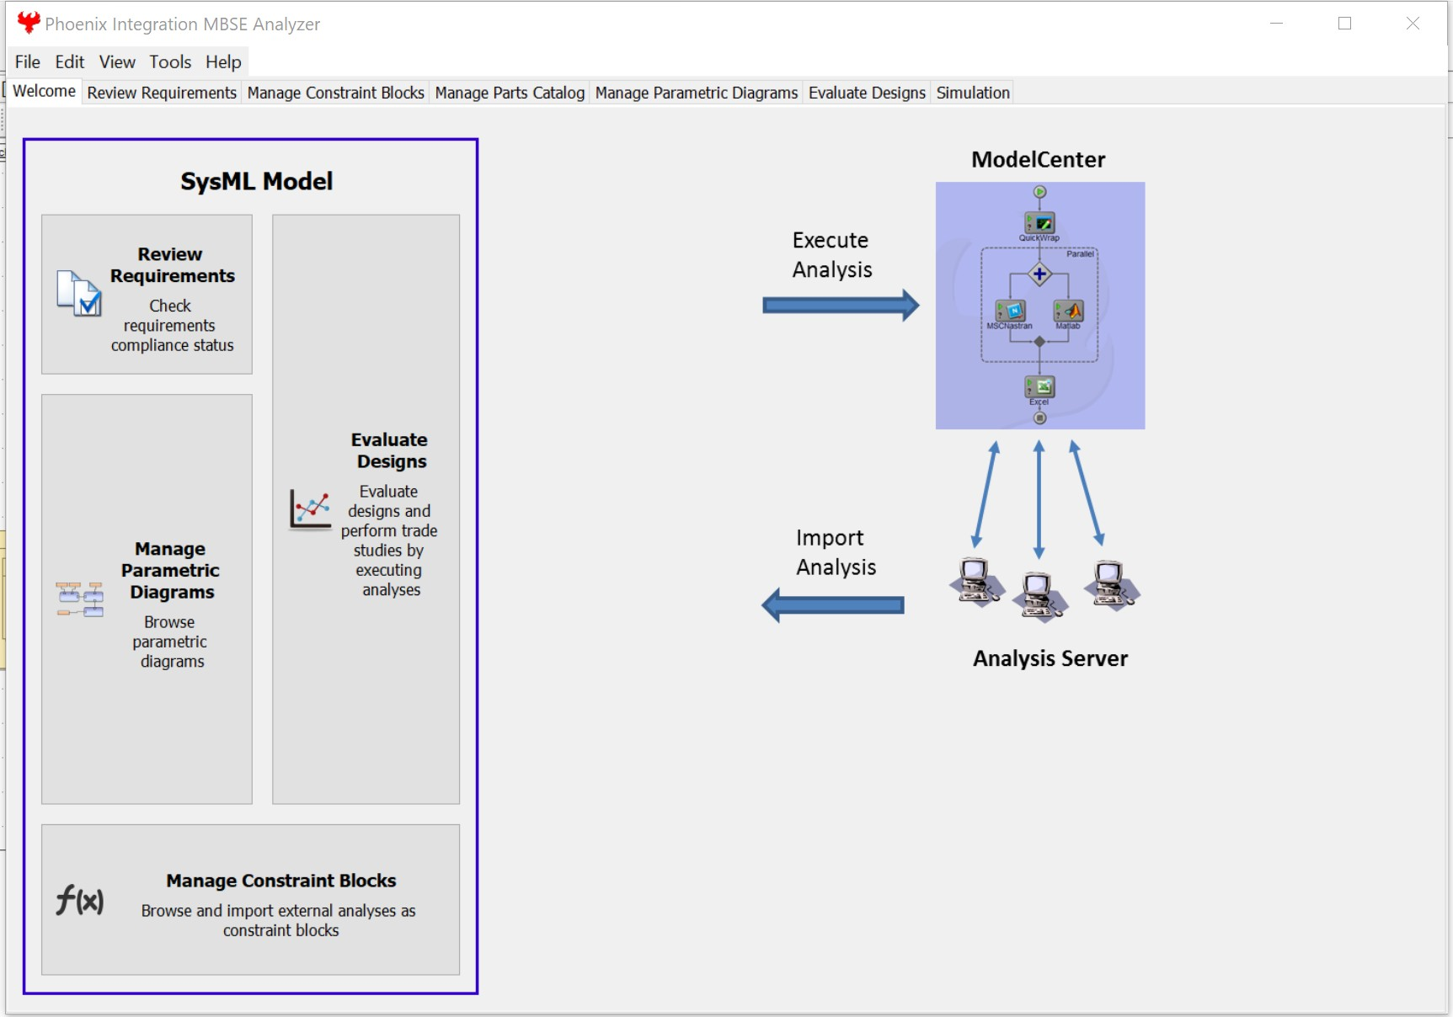
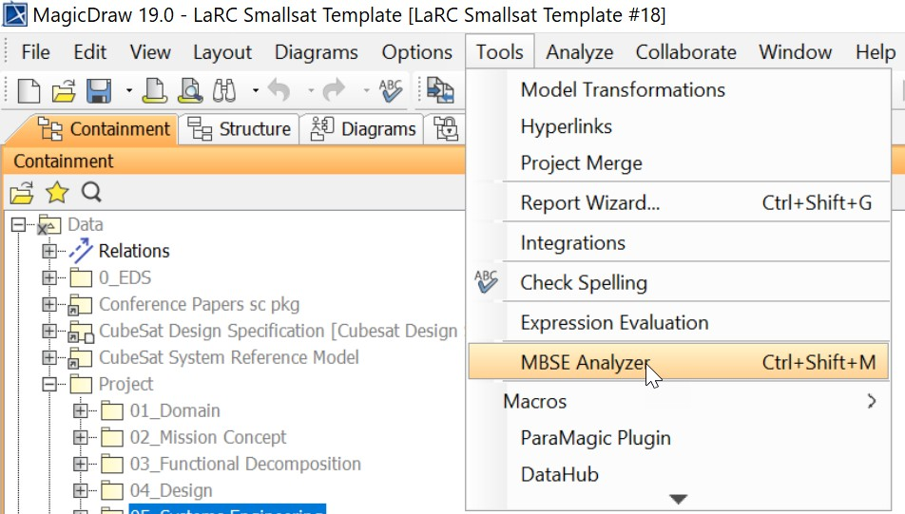
Trade Studies with ModelCenter
All generic analyses (mass and cost) are located in Analysis package
Within the Analysis package there are options for analysis,
Analysis patterns – e.g. mass roll-up definition
Constraints – constraint blocks created through MBSEAnalyzer
Mass roll-up – mass analysis context
SSCM14 analysis – cost analysis context based on Aerospace’s SmallSat Cost Model 2014 (SSCM14)
Multi_Objective_Function – combined mass and cost performance metrics into a composite equally weighted score.
All analysis results will be saved (from MBSEAnalyzer) as block’s instances in Trade Studies package.
O R
MBSE
Lightning Round
12
12

Slide 13
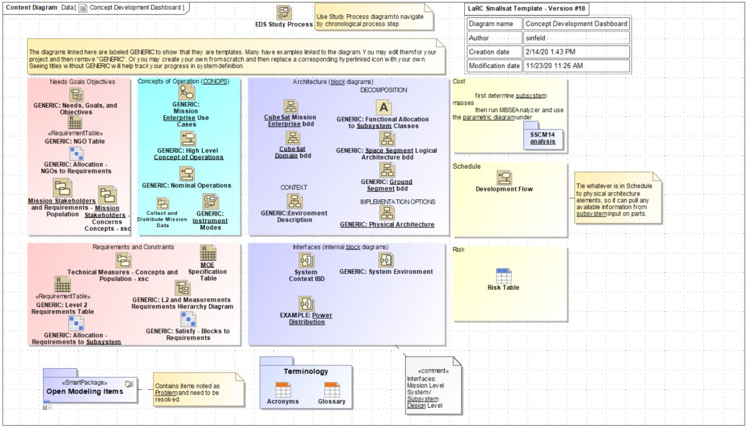
Component Library Loading Current Work
Development in Python to scrape data from satellite parts database (e.g. SPOON) and PDF spec sheets to directly populate into component library (Excel or SQL)
SQL database of components to use with METIS Cameo plug-in (developed as SBIR) for loading components as instances; also based on CSRM
METIS (Orbital Transports) will have some trade study presets too in future versions
Component Data
Python scraper
LaRC SmallSat component library
MagicDraw plugin
MBSE
Lightning Round
www.incose.org/iw2021/
13

Slide 14

www.incose.org/iw2021/
MBSE
Lightning
Round

